Slide 1

Customer Segmentation Using K- means Clustering
PRESENTED BY GROUP-8

Slide 2
CONTENT
1.INTRODUCTION
2.UNDERSTANDING K-MEAN CLUSTERING
3.LITERATURE
4.DATA PROCESSING
5.CHOOSING THE OPTIMAL K
6.FEATURE SELECTION
7.INTERPRETING CLUSTER RESULT
8.TARGETED MARKETING STRATEGIES
9.PERSONALIZED CUSTOMER EXPERIENCE
10.MEASURING SEGMENT PERFORMANCE
11.CHALLENGES AND LIMITATION
12.FUTURE TRENDS IN CUSTOMER SEGMENTATION
13.CONCLUSION

Slide 3

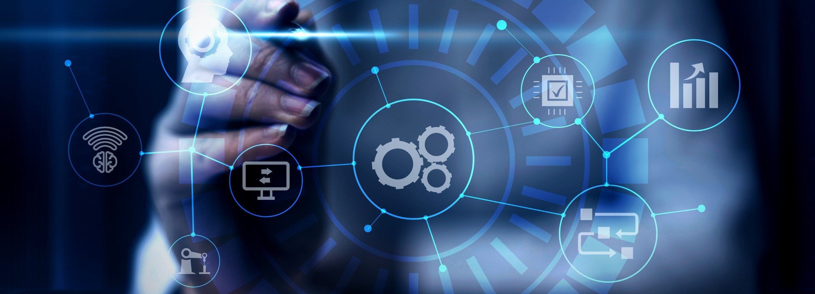
Introduction
Introduction to Customer Segmentation using K-means Clustering. This method helps businesses understand and group customers based on similarities in behavior and preferences. It is a powerful tool for targeted marketing and personalized customer experiences.

Slide 4


Understanding K- means Clustering
Exploring the K-means Clustering algorithm. It is an unsupervised machine learning technique that partitions data into K clusters based on similarity. The algorithm iteratively assigns data points to the nearest cluster centroid and recalculates centroids until convergence.

Slide 5
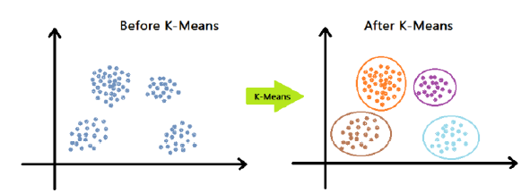
LITERATURE
Customer segmentation using K-means clustering is a popular technique in marketing to group customers based on their similarities and differences. Recent studies have shown the effectiveness of K-means clustering in segmenting customers based on purchasing behavior, demographic and behavioral data, social media data, and transactional data. The optimal number of clusters can be determined using various methods, such as the elbow method, the silhouette method, and the gap statistic method. The resulting clusters can provide valuable insights into customer segments and inform marketing strategies

Slide 6

Data Preprocessing
Importance of Data Preprocessing in customer segmentation. This step involves cleaning, transforming, and scaling the data to ensure accurate clustering results. It includes handling missing values, standardizing features, and encoding categorical variables.

Slide 7
Feature Selection
Identifying relevant features for customer segmentation. Selecting the right attributes such as demographics, purchase history, and online behavior is crucial for creating meaningful customer segments that drive actionable insights.

Slide 8
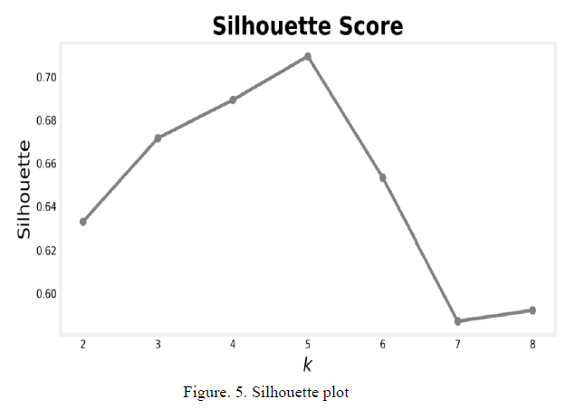
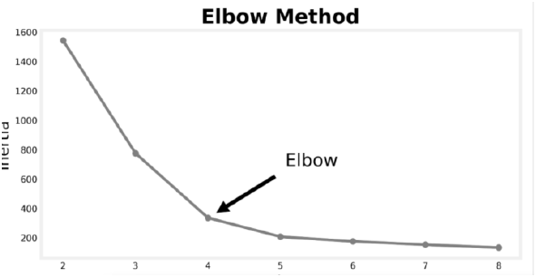
Choosing the Optimal K
Selecting the optimal number of clusters, K, in K-means Clustering. Techniques such as the Elbow Method and Silhouette Score help determine the most suitable value for K based on within-cluster sum of squares and cluster cohesion.

Slide 9
Interpreting Cluster Results
Understanding and interpreting the cluster results. Analyzing the characteristics and behaviors of customers within each cluster to gain insights into distinct segments. This step involves proﬁling and labeling clusters for actionable marketing strategies.

Slide 10


Targeted Marketing Strategies
Leveraging customer segmentation for targeted marketing. Tailoring products, promotions, and messaging to address the speciﬁc needs and preferences of each customer segment. This approach enhances customer engagement and drives higher conversion rates.

Slide 11
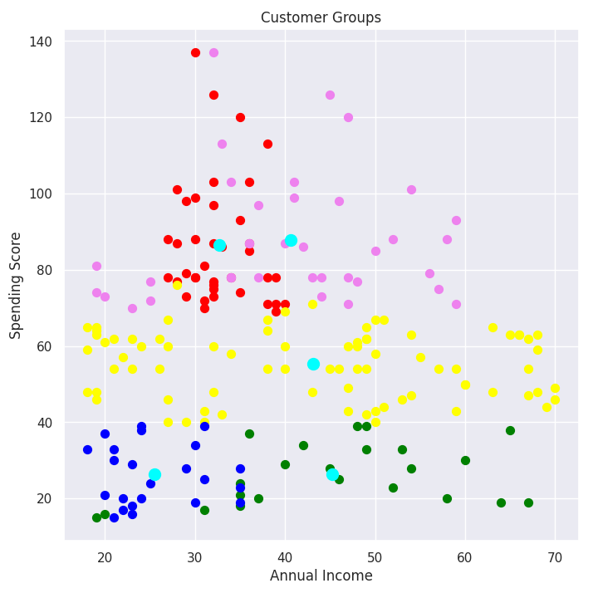
Personalized Customer Experiences
Delivering
personalized experiences based on customer
segments.Customizing communication, product recommendations, and interactions to create a unique journey for each segment. This fosters customer loyalty and satisfaction.

Slide 12


Measuring Segment Performance
Evaluating the performance of customer segments. Utilizing metrics such as conversion rate, retention rate, and customer lifetime value to assess the effectiveness of segmentation. This enables continuous optimization of marketing strategies.

Slide 13
Challenges and Limitations
Exploring the challenges and limitations of K- means Clustering in customer segmentation. Factors such as feature selection, cluster interpretation, and scalability can pose potential obstacles in achieving accurate and actionable segmentation results.

Slide 14
Future Trends in Customer Segmentation
Emerging trends and advancements in customer segmentation. Innovations such as AI-driven clustering and real- time segmentation are shaping the future of personalized marketing. These developments offer enhanced precision and agility in segmenting customers.

Slide 15

Conclusion
Summarizing the key takeaways from customer segmentation using K-means Clustering. This approach enables businesses to gain valuable insights, drive targeted marketing, and deliver personalized experiences, ultimately fostering customer loyalty and maximizing ROI.

Slide 16

Thanks!

